Slide 1
Restaurant Management System
Shruti Shinde
2402669
Raghav Kaushik
2407245
Sara Deshmukh
2405850
Seher Sanghani
2403936
Introduction to Computer Science and Programming II
FY Tech
2024-25

Slide 2
Technology Stack
Restaurant Management System
Backend: Flask(python):
Routes: (/ , /admin, /order, /review)
Database: MySQL
Tables Created: buffet_menu, a_la_carte_menua, orders, review
Frontend: HTML
Index.html: to handle the home page of the webpage
Admin.html : to handle the admin panel like add, update and delete

Slide 3
List of exceptions handled using exception handling (include any custom exception if any)
Restaurant Management System
ValueError:
Raised when invalid or incorrect data types are provided for item price or quantity.
MySQLInterfaceError:
Occurs when there are issues in SQL query execution or invalid column references.
OperationalError:
Handles database connection errors or issues during committing transactions.
KeyError:
Catches errors if the expected key is missing when handling form data or dictionary operations.
Custom Exception (ItemNotFoundError):
Raised when an item is not found during update or delete operations.

Slide 4
List of Classes
Restaurant Management System
DatabaseConnector:
Establishes connection with the MySQL database
Handles query execution and commits transactions.
MenuManager:
Manages menu operations such as: adding items to the buffet_menu or a_la_carte_menu, deleting the items and updating the items
OrderManager:
Handles customer orders for both buffet and à la carte.
Stores the data in the order table
ReviewManager:
Manages the customer review

Slide 5
OOPM Concepts used
Restaurant Management System
Abstraction (Abstract classes / methods):
Hides database operations within DatabaseConnector class
Methods like add_buffet_items() and update_item has encapsulated query
Encapsulation using access specifier (private or protected variables):
Private variables(self.conn, self.cursor) in DatabaseConnector class
Access and modifiy the data
Polymorphism? (Type of Polymorphism):
Methods like update_item() handle both buffet and a la carte items, implementing method overriding behaviour in class MenuManager() and class OrderManager().

Slide 6
OOPM Concepts used
Restaurant Management System
Class Methods:
Used in OrderManagement() in place_order()
Contructor:
In DatabaseConnector class __init__() is used to iinitializes the connection with database.
Other classes also use constructors to establish a database connection using instance of the database.

Slide 7
Regular expression used:
Restaurant Management System
Regular expression used for Admin Password verification:
Pattern: ^(?=.*[A-Z])(?=.*[a-z])(?=.*\d).{8,}$
At least one uppercase
At least one lower case
At least one digit
Minimum length of the password is 8
Applied in admin_add_item()

Slide 8
Database used:
Restaurant Management System
DATABASE USED : The databased used in this project is MySQL
Tables Used:
Buffet_menu
Columns: item_name, section, price
A_la_carte_menu
Columns: item_name, price
Orders
Columns: order_id, item_name, quantity, total_name
Reviews
Columns: review_id, customer_name, review

Slide 9
Web Development Framework used:
Restaurant Management System
Flask
How many routes added in Flask is 4
/ - Home Page (index.html)
/admin – Admin Panel (admin.html)
/order – Handles the order placement
/review – Handles the review submission

Slide 10
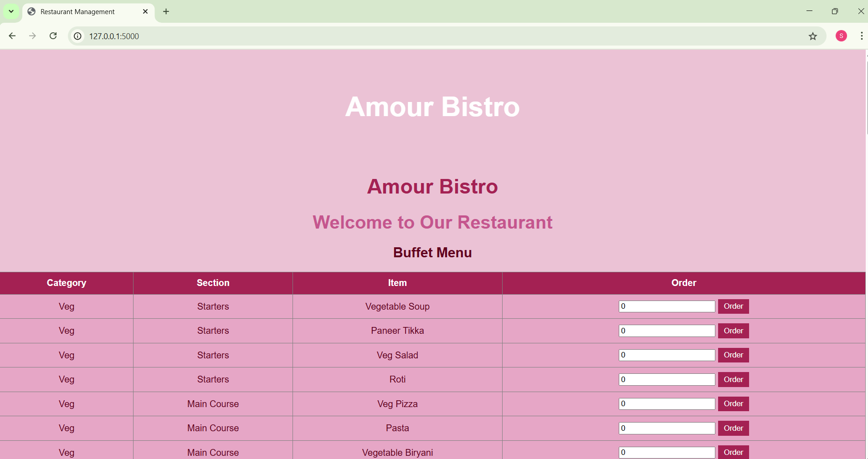
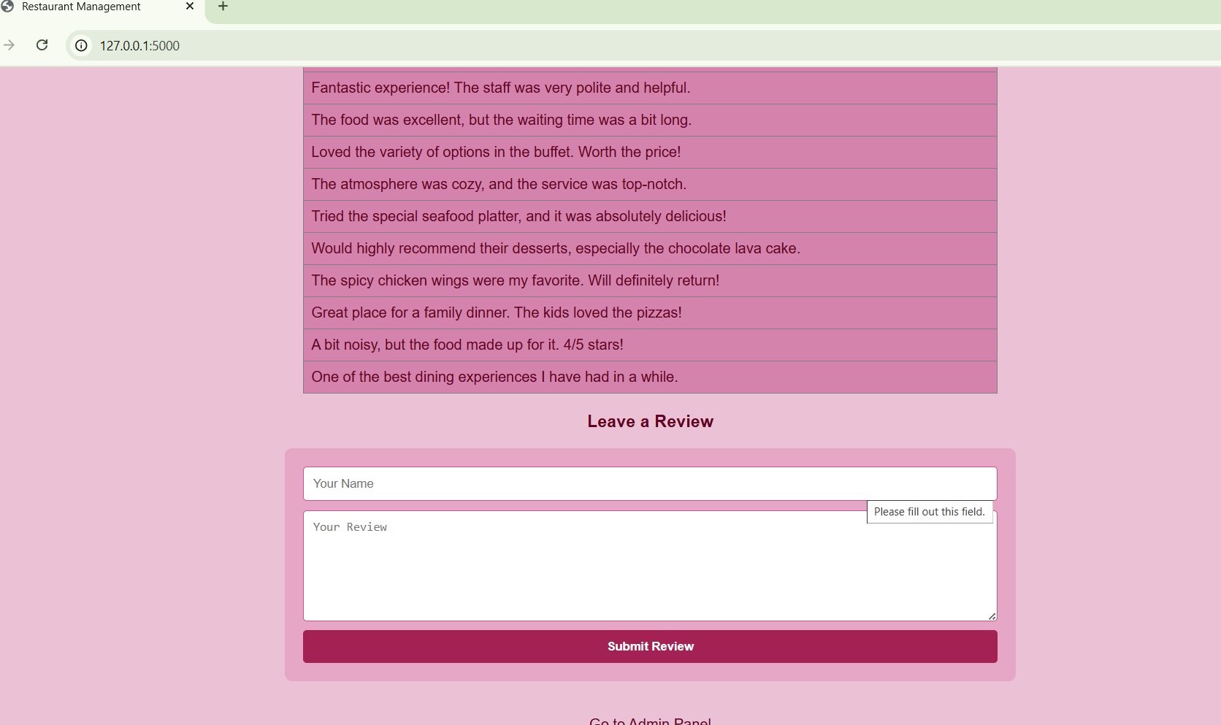
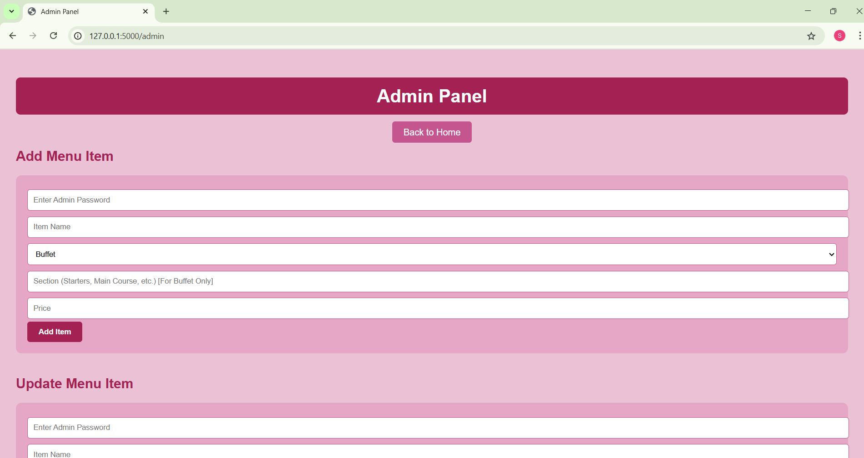
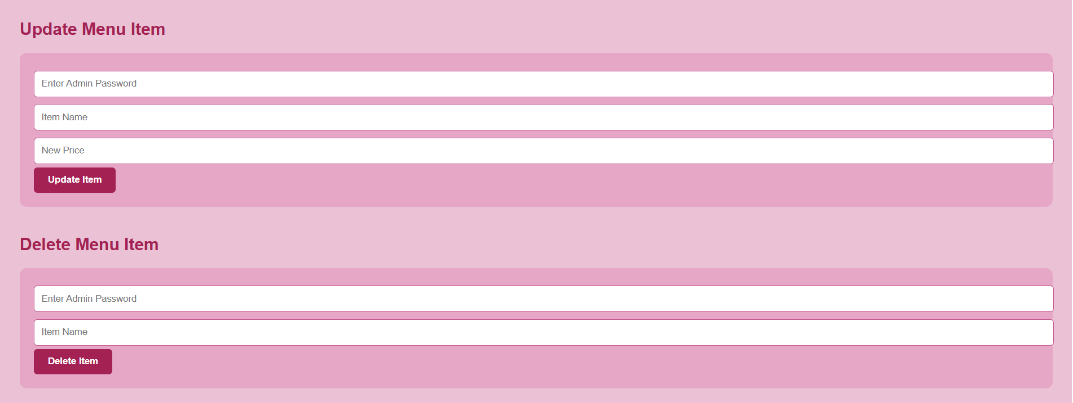
Front End Screenshot:
Restaurant Management System

Slide 11
Individual Contribution:
Restaurant Management System
Shruti Shinde:
Python code, flask, admin panel, database (Mysql Code),ppt
Raghav Kaushik:
Python code, ppt
Sara Deshmukh:
Database Connector, ppt
Seher Sanghani:
home page(index.html), python, database, ppt

Slide 12
Group Photo with Title slide:
Restaurant Management System

Slide 13
Thank You!!!

